Slide 1
Schema Mapping using ML model

Slide 2
Models Used
Multinomial NB classifier
Langchain
GPT - Currently Working

Slide 3
Multinomial NB Classifier and Random forest Classifier
Pros:
Able to get the prediction of columns having alphanumeric values.
This model stores existing data in memory for classification.
Cons:
It is giving predictions based on training data only.
For new data it may predict wrong column names as well.
This model trained only on alphanumeric value columns.
This model cannot classify numeric column as well as dates colum.

Slide 4
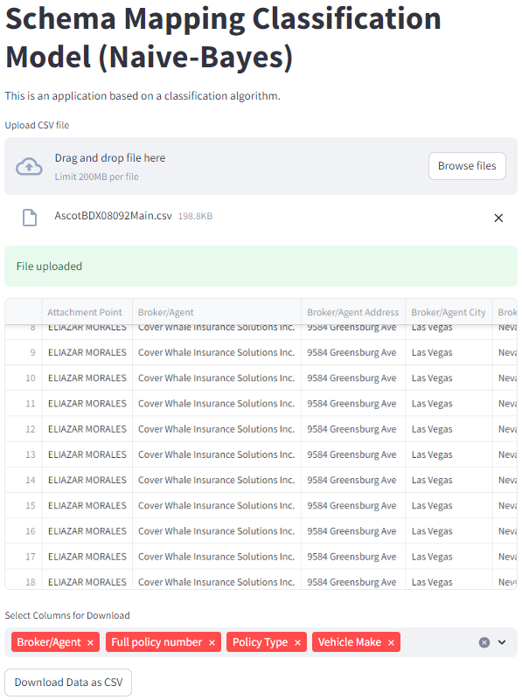

Slide 5
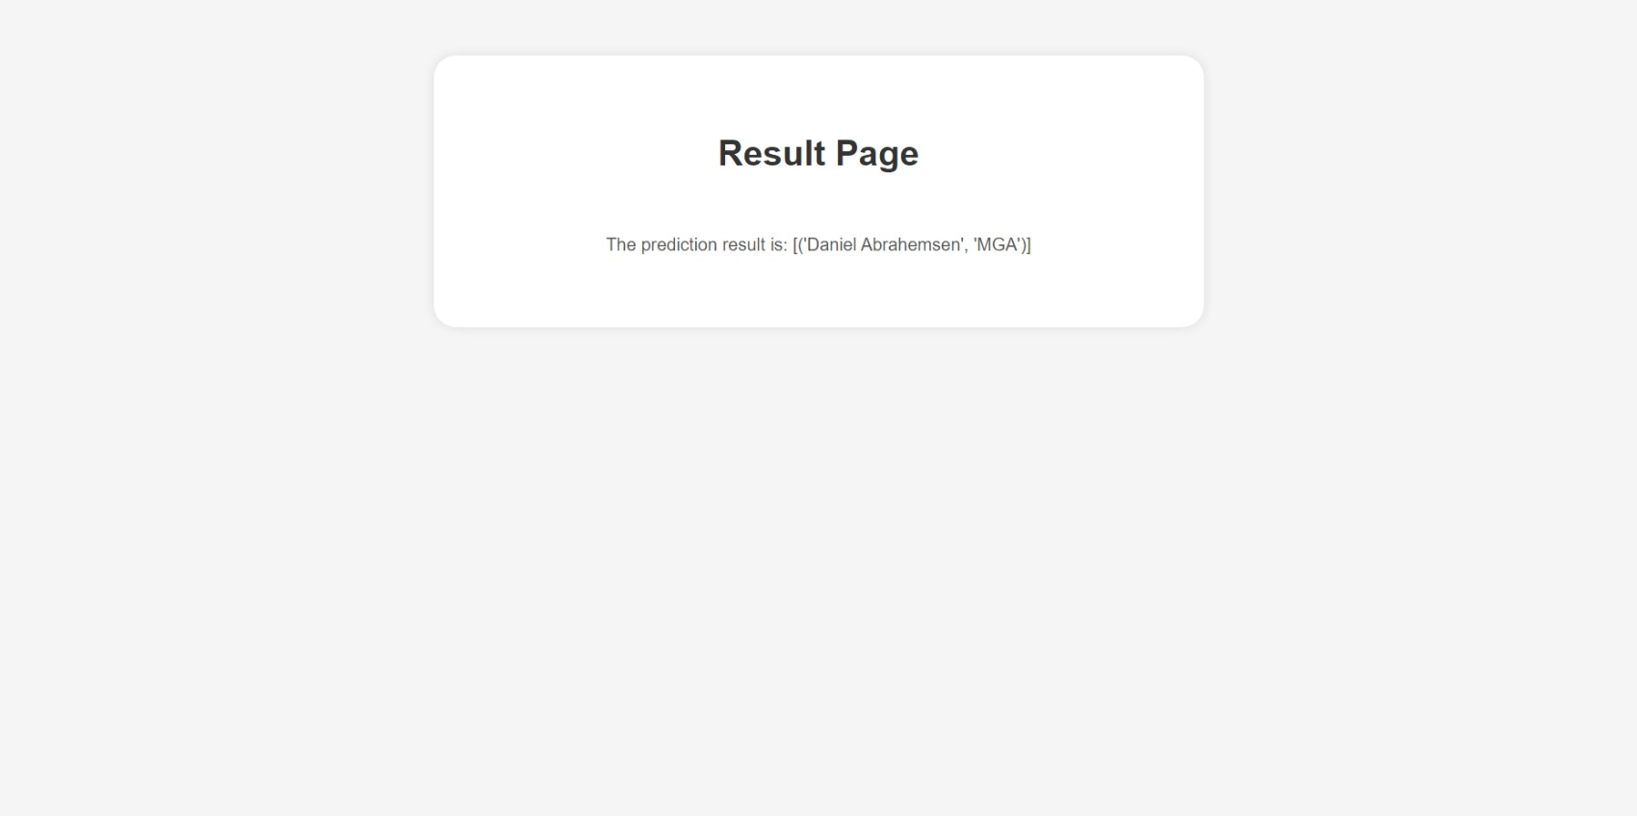

Misclassification by NB model

Slide 6
Langchain
pros:
It is better than ML classification model as it is nlp based (language) pretrained language model.
It gives output based on content provided to it.
Cons:
It is chat based model and the output format keeps changing on each execution.
It considers an accurate content to predict the outcome.
It can classify column name based on mappings provided to it but it creates new column name based on incoming column name.

Slide 7
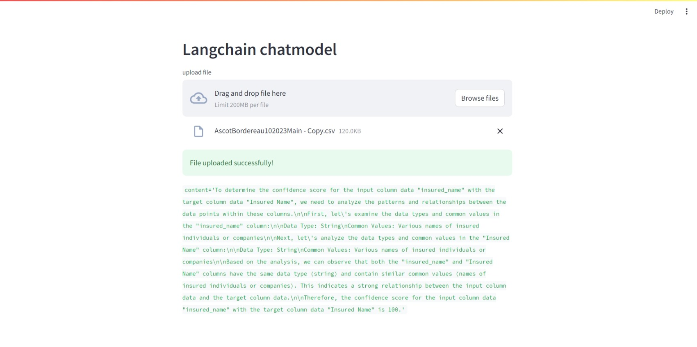

Slide 8
GPT
pros:
It is a Pretrained model trained on large corpus of data for more accurate results.
The model can be adapted to perform specific tasks, enhancing its performance for applications like column mapping and data analysis.
It is a prompt and completion based model so we can provide prompt which includes information about column mapping as well as data present inside those columns.
Prompts can be modified as per the requirement to make the model more generalized.
Fine-tuning a pre-trained model typically requires fewer training iterations than training a model from scratch.
Cons:
To fine-tune the GPT based model , it requires subscription i.e paid account.
We may require to change our prompt multiple times based on the output of gpt fine-tune model.

Slide 9
GPT Prompt Example
{"prompt":"You will be given a Dataframe with input column and data associated with the columns.\nExamine the dataset with column name 'MGA'. This would be your target column.\n Alternative names for this column include: 'Company_Code; Agent; Program Administrator; producer_firm_name; Managing General Agent'.\nConsider the data provided 'Arrowhead General Insurance Agency Inc,Arrowhead General Insurance Agency Inc,Arrowhead General Insurance Agency Inc,Arrowhead General Insurance Agency Inc,Arrowhead General Insurance Agency Inc,Arrowhead General Insurance Agency Inc,Arrowhead General Insurance Agency Inc,Arrowhead General Insurance Agency Inc,Arrowhead General Insurance Agency Inc,Arrowhead General Insurance Agency Inc,Arrowhead General Insurance Agency Inc,Arrowhead General Insurance Agency Inc,Arrowhead General Insurance Agency Inc,Arrowhead General Insurance Agency Inc,Arrowhead General Insurance Agency Inc,Arrowhead General Insurance Agency Inc,Arrowhead General Insurance Agency Inc,Arrowhead General Insurance Agency Inc,Arrowhead General Insurance Agency Inc,Arrowhead General Insurance Agency Inc,Arrowhead General Insurance Agency Inc,Arrowhead General Insurance Agency Inc,Arrowhead General Insurance Agency Inc,Arrowhead General Insurance Agency Inc,Plimsoll Specialty Markets LLC,Marsh USA Chicago, Inc., ,Marsh USA Chicago, Inc., ,Marsh & McLennan Agency,Marsh & McLennan Agency,Travers & Associates,Travers & Associates,Travers & Associates,Wings Insurance ,Halton Hall & Associates, Inc.,Halton Hall & Associates, Inc.,Wings Insurance ,Wings Insurance ,Travers & Associates,Wings Insurance ,Avion Insurance Agency, Inc,Wings Insurance ,Plimsoll Specialty Markets LLC,Travers & Associates,Travers & Associates,Halton Hall & Associates, Inc.,Travers & Associates,Wings Insurance ,Avion Insurance Agency, Inc,Daniel Abrahamsen,Daniel Abrahamsen,Daniel Abrahamsen,Daniel Abrahamsen,Daniel Abrahamsen,Daniel Abrahamsen,Daniel Abrahamsen,Daniel Abrahamsen,Daniel Abrahamsen,Daniel Abrahamsen,Daniel Abrahamsen,Daniel Abrahamsen,Daniel Abrahamsen,Daniel Abrahamsen,Daniel Abrahamsen,Daniel Abrahamsen,Daniel Abrahamsen,Daniel Abrahamsen,Daniel Abrahamsen,Daniel Abrahamsen,Daniel Abrahamsen,Daniel Abrahamsen,Daniel Abrahamsen,Daniel Abrahamsen,Daniel Abrahamsen,Daniel Abrahamsen,Daniel Abrahamsen,Daniel Abrahamsen,Daniel Abrahamsen,Daniel Abrahamsen,Daniel ' present in the 'MGA' target column to learn the patterns and characteristics.\nAttempt to discern any discernible patterns, such as data types, common values, or trends.\nPay attention to any potential relationships between data points within this column.\nIf there are null values, feel free to disregard them in your analysis.\nYour goal is to find the relationship between the input column and target column based on either the data or the column name and return the closest match based on your analysis.If input column and target column are same, then the 'confidence score' should be evaluated as 100. If a relationship between input column and target column cannot be established, then the 'confidence score' is 0. Return the confidence score","completion":" Based on the analysis, the provided entry is likely associated with the 'MGA' column. Confidence score is: 100 \nBased on the analysis, the provided entry is not likely associated with the 'MGA' column. Confidence score is: 0"}

Slide 10
Pricing Comparison
Total price(in dollars) | Price in (Indian Rupees) |  | Platform
6.06 | 509.04 | This is for single trial** | OpenAI
12.04 | 1011.36 | This is for single trial** | AzureAI

